Slide 2
Sessions about to start –
Get your RIG on!

Slide 3
30 common tasks you perform using the GUI that you can do faster in Windows PowerShell
Orin Thomas
@orinthomas
DCI316

Slide 4
Server administrators are creatures of habit

Slide 5
We learn how to do things a convenient way … and then we keep doing it that way.

Slide 6
Take figuring out an IP address …

Slide 7
Who doesn’t love ipconfig /all?

Slide 8
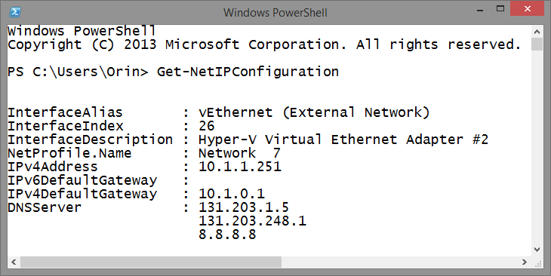
1: Replace ipconfig /all
Get-NetIPConfiguration

Slide 9
Mucking around trying to figure out network adapter names …

Slide 10
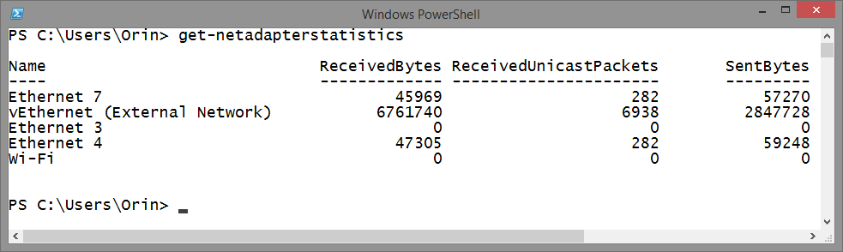
2: Network adapter names?
Get-NetAdapter
Get-NetAdapterStatistics

Slide 11
Manually configuring an IPv4 address?

Slide 12
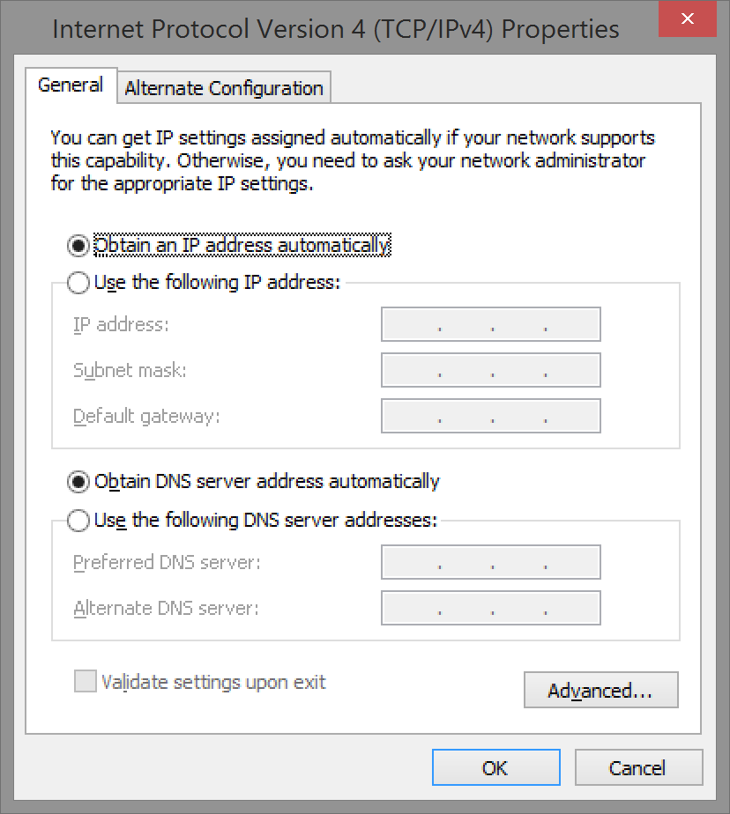
Familiar with this dialog box?

Slide 13
3: Configure the IP Address
New-NetIPAddress -InterfaceAlias Ethernet -IPAddress 172.16.0.20 -PrefixLength 24 -DefaultGateway 172.16.0.1

Slide 14
4: Configure the DNS Server
Set-DNSClientServerAddress -InterfaceAlias "Ethernet" -ServerAddresses 172.16.0.10

Slide 15
Network Connectivity

Slide 16
We all ping our favourite host …

Slide 17
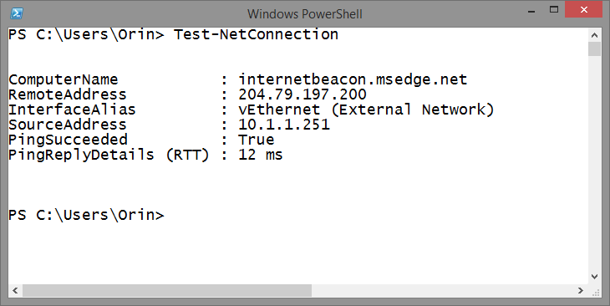
5: Ping
Test-NetConnection
(by itself it contacts internetbeacon.msedge.net)

Slide 18
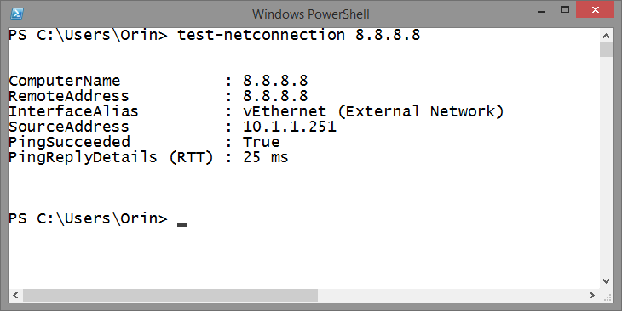
5a: Ping
Test-NetConnection 8.8.8.8

Slide 19
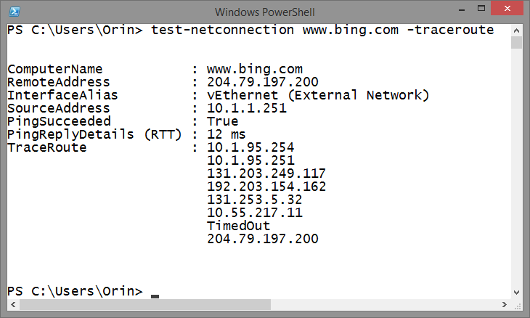
6: Tracert
Test-NetConnection www.bing.com –Traceroute

Slide 20
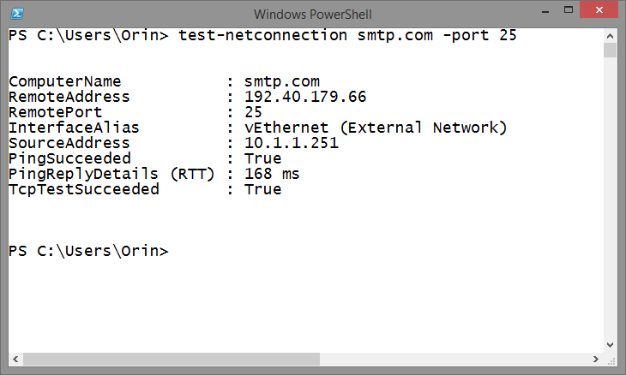
7: Telnetting to a port
Test-NetConnection www.bing.com –Port 80
Test-NetConnection smtp.com –Port 25

Slide 21
Restarting a recalcitrant service?

Slide 22
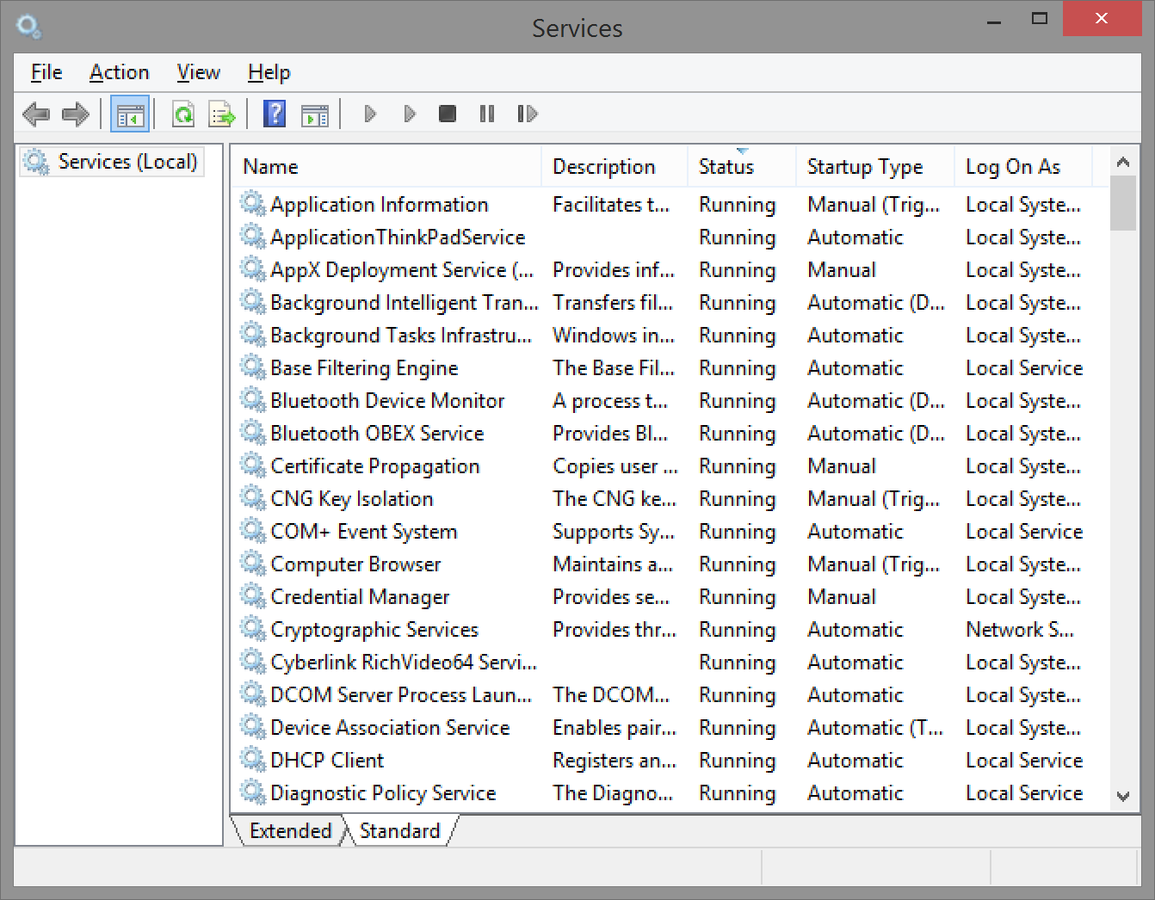
Managing a service?

Slide 23
8:Restart a service
Restart-Service

Slide 24
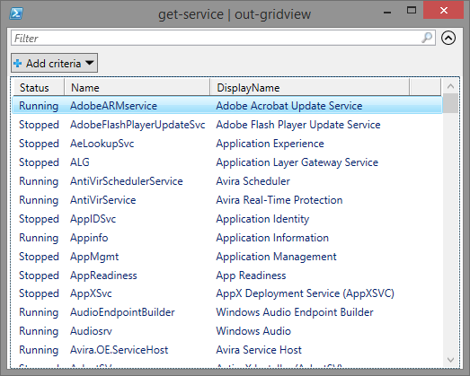
9: Get-Service
View all services:
Get-Service | Out-Gridview

Slide 25
10: Stop, Start, and Set-Service
Stop-Service
Start-Service
Set-Service

Slide 26
Names & Domains

Slide 27
11: Computer rename
Rename-Computer AU-TechEDDemo

Slide 28
12: Computer Restart
Restart-Computer

Slide 29
13: Computer Shutdown
Shutdown-Computer

Slide 30
14: Domain Join
Add-Computer -DomainName adatum.internal

Slide 31
15: Add Roles and Features
Install-WindowsFeature
-IncludeAllSubfeature
-IncludeManagementTools File-Services

Slide 32
15a: .NET Framework
Install-WindowsFeature Net-Framework-Core -source d:\sources\sxs

Slide 33
Demo

Slide 34
16: Fix computer’s trust relationship
test-computersecurechannel -credential domain\admin -Repair

Slide 35
17: Only for testing
This slide layout uses Consolas, a monotype font which is ideal for showing software code.

Slide 36
18: Add a firewall rule
New-NetFirewallRule -DisplayName “Allow Inbound Port 80" -Direction Inbound –LocalPort 80 -Protocol TCP -Action Allow
New-NetFirewallRule -DisplayName "Block Outbound Port 80" -Direction Outbound –LocalPort 80 -Protocol TCP -Action Block

Slide 37
Virtual Machines

Slide 38
19: Create a VM
New-VM -MemoryStartupBytes 2048MB -Name SYD-VM
-Path "d:\SYD-VM"
-VHDPath "d:\SYD-VM\prep-disk.vhdx"

Slide 39
20: Assign VM Network
GET-VM –name SYD* | GET-VMNetworkAdapter | Connect-VMNetworkAdapter –Switchname ‘Private Network’

Slide 40
21: Checkpoint VMs
Get-VM | CheckPoint-VM

Slide 41
Demo

Slide 42
22: Password Reset
$newpwd = ConvertTo-SecureString -String "P@ssw0rd" -AsPlainText –Force
Set-ADAccountPassword Optimus
-NewPassword $newpwd –Reset
Set-ADAccountPassword Optimus
-NewPassword $newpwd -Reset -PassThru | Set-ADuser -ChangePasswordAtLogon $True

Slide 43
23: Locate FSMO Roles
Get-ADForest adatum.com | FT SchemaMaster
Get-ADForest adatum.com | FT DomainNamingMaster
Get-ADDomain adatum.com | FT PDCEmulator
Get-ADDomain adatum.com | FT InfrastructureMaster
Get-ADDomain adatum.com | FT RIDMaster

Slide 44
24: Seize FSMO Roles
Move-ADDirectoryServerOperationMasterRole
-Identity NEW-DC -OperationMasterRole RIDMaster,InfrastructureMaster,
DomainNamingMaster -Force

Slide 45
25: Enable Remote Desktop
set-ItemProperty -Path 'HKLM:\System\CurrentControlSet\Control\Terminal Server'-name "fDenyTSConnections" -Value 0
Enable-NetFirewallRule -DisplayGroup "Remote Desktop"

Slide 46
Demo

Slide 47
26: Check Updates
Get-Hotfix

Slide 48
27: Date and Timezone
Set-date "12/12/2014 10:30 PM“
(Get-WmiObject win32_timezone).caption
TZUTIL /s “AUS Eastern Standard Time"

Slide 49
Demo

Slide 50
28: Password Never Expires
Search-ADAccount –PasswordNeverExpires
| out-gridview

Slide 51
29: Inactive Accounts
Search-AdAccount –accountinactive –timespan 90.00:00:00 | out-gridview

Slide 52
30: Locked Out and Disabled accounts
Search-AdAccount –Lockedout | out-gridview
Search-AdAccount –AccountDisabled | out-gridview

Slide 53
Thanks!

Slide 54
Please complete your session/speaker evaluation
Go to: aka.ms/mytechedsyd

Slide 55
Q&A

